Slide 1
Exploring and living in Canada
Lesson 1: Getting to know each other

Slide 2
Overview
This lesson serves as an introduction course. It allows students to introduce themselves. Students will also learn about how they present their information via forms and polite and impolite conversation topics/subjects.
The learners will be able to
• demonstrate familiarity with polite topics of conversation in a social setting
• fill out a simple form
• write a short letter about a favourite place in Canada

Slide 3
Personal Information
Take a minute to think about your personal information
Answer the following questions out loud by yourself. You do not need to submit this part
What is your first name? What is your last name? What is your phone number? What is your address? What do you like to do for fun? What do you like to eat? What is your favorite TV show?

Slide 4
Autobiography

Slide 5
Your task
https://www.youtube.com/watch?v=_FKr_fcPJY8
Your task will be to introduce yourself by creating and autobiography

Slide 9
Review the sample autobiography on moodle.
Your job is to write a 2 page autobiography discussing your life. Use the questions we just went over as a guideline
Steps:
1) Answer the questions in the previous slides
2) Using your answers for the questions, create paragraphs for your autobiography
3) Check for spelling and grammar. Read your autobiography out loud. This will help you catch errors.

Slide 10
Forms
What is a form?
A form is a document with spaces in which to write or select, for a series of documents with similar contents. The documents usually have the printed parts in common, except, possibly, for a serial number. Forms, when completed, may be a statement, a request, an order, etc.
You enter your personal information onto a form for a variety of reasons
Lets take a look at sample forms
Most forms have similar construction and format, and most ask for some information that is familiar and some that may not be familiar.

Slide 11
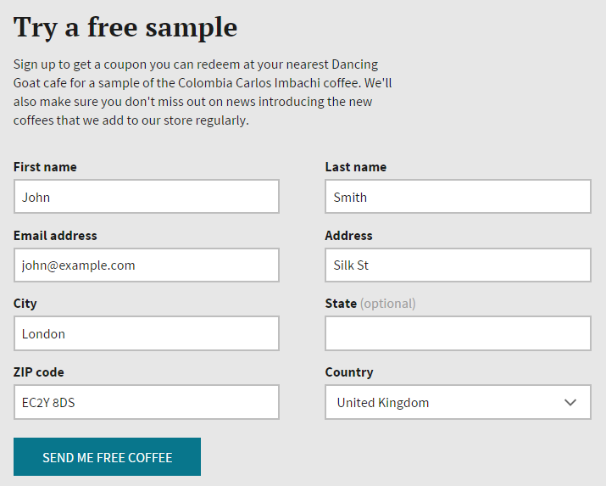
Look for similarities and differences in these forms

Slide 12
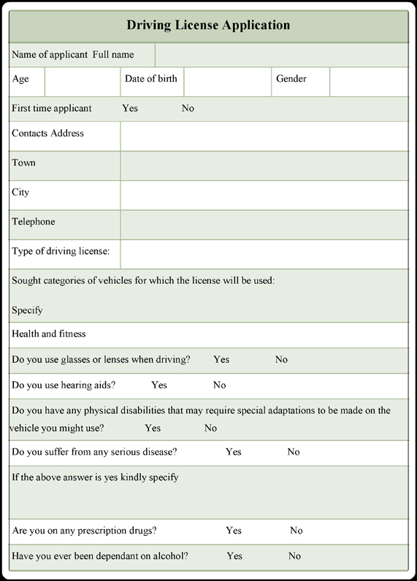
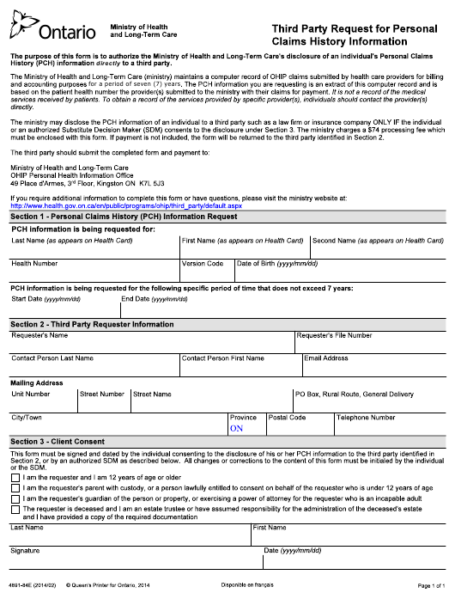

Slide 13
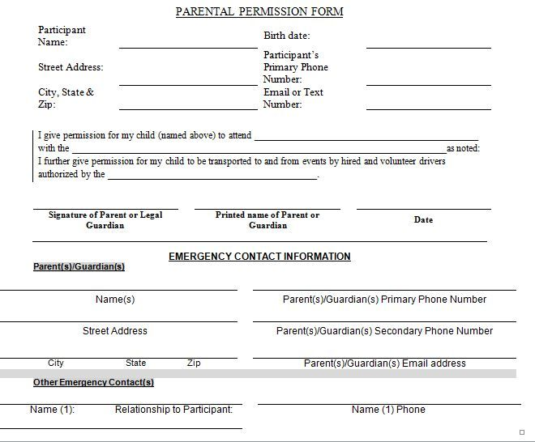
One type of form that parents with children in the school system will often be required to fill out
- Pretend you are filling out these forms, what would you write?

Slide 14
Customs and social behaviour
As a new immigrant, you may be VERY surprised to learn that there are a lot of topics that in Canadian culture are considered inappropriate (not good) or even taboo! When you are talking to your close friends, your family members or your doctor, all the topics are good. But be careful with your new friends or any new people (that includes people you work with in the same company).

Slide 15
Check your thinking – Answer the following questions
1. In a casual conversation with a new person, the question “How old are you?” is
a) appropriate b) not appropriate c) only appropriate with young people and children
2. Sports, pets, food and shopping are
a) all good topics for a casual conversation b) only appropriate with some people c) not appropriate in a conversation
3. When it comes to politics, Canadians
a) don’t discuss it b) discuss it rarely c) discuss it with close friends only d) discuss it with everybody
4. Co-workers in Canada
a) usually discuss salaries b) don’t discuss salaries c) only discuss salaries after work
5. Question ‘Are you married?’ can show
a) sexual interest b) friendliness c) interest in the other person
6. Which of these topics are appropriate to make jokes about: women, race, religions, other cultures?
a) all of these b) none of these c) women d) religion e) women and other cultures

Slide 16
DO NOT DISCUSS:
health problems
money/salary
religion
age
children
marriage
politics

Slide 17
Health
Never ask a person ‘How is your health?’ This is very personal and this information is reserved for a discussion with a person’s doctor. If a person had complained to you about a headache or a sore throat, it’s appropriate to ask how they feel, but anything more serious (for example a surgery) is usually only discussed with close friends.
Never tell a person: ‘You look tired.’ or ‘You look sick.’ It will only make them feel worse. If you want to show that you care, ask ‘How are you?’ or ‘Are you okay?’
Money
Never ask a co-worker or a new friend ‘How much did you pay for your house/car/any expensive item?’ or ‘What’s your salary?’ Again, this information is for close friends only. If you want to know how much somebody is earning, you will need to google that information to know their approximate salary. Co-workers in Canada do not compare salaries.
The only way you can ask about an expensive item is if you are trying to buy the same/similar one. In that case, you should say: “I’m looking for a jacket just like this. Would you mind if I ask you how much you got it for?”

Slide 18
Religion
Canada is a multicultural country with people of many religions living together as neighbours. We focus on things that we share and have in common, and not the things that divide us. It is not appropriate to ask ‘What is your religion?’ or ‘Are you a Christian/Muslim?’ You can tell people about your religion but do not ask them about theirs. If they want, they will share this information with you, but many people consider this a very personal topic.
Age
Never ask a person ‘How old are you?’ This question is only appropriate for children. Do not comment on how a person looks ( Don’t say ‘Oh, you look so young!’) People’s age doesn’t matter – we respect both young and old. What matters is your personality and your skills.
It is not polite to call a person ‘old’ (don’t say ‘He is old.’ Say: ‘He is a senior.’) Also, never say ‘old woman’. We say ‘elderly lady’.
Children
Do not ask a person ‘How many children do you have?’ or ‘Why do you only have one child?’ or ‘Are you going to have more children?’
Wait and listen. If a person tells you ‘I have a daughter’, it is okay to ask them how old their daughter is. But be careful: do not ask them if they have other children. Remember: it is possible that a woman wants to have children or more children but she cannot and the doctors can’t help her. Infertility is a big problem in the Western world. Also, remember that many people in Canada choose not to have children.

Slide 19
Marriage
Many couples in Canada choose to have a common law relationship. This means that people live together as a family but they do not sign any papers. Do not ask a person ‘Are you married?’ unless you want to date them (it could be interpreted as sexual interest). Listen to what they say – if they say ‘my husband/wife’ you know they are married. If they always say ‘John/Mary/my partner’ it means they are not.
Politics
It is acceptable to discuss political news with everybody. However, do not ask a person any question about how they voted in the election or which political party they support – this is personal. Again, the person may choose to tell you about their political views but do not directly ask them ‘Who did you vote for?’
______
Jokes
Do not make jokes about women, religion, race or other cultures. These jokes may really upset some people and you will make enemies instead of friends.
We use conversation to make friends and build relationships. A carefully chosen topic(s) will help you build GOOD RELATIONSHIPS. People will appreciate and respect you because you will have a reputation of being tactful, diplomatic and considerate.

Slide 20
WHAT CANADIANS TALK ABOUT
Acceptable topics for casual conversations with your new friends and co-workers include:
weather
current news (but not all news)
movies, TV shows
sports
pets
food
shopping
technology
shared hobbies or interests
work
art and other entertainment
travel
family and children (but only if you already know that the other person has family and children!)
plans for the weekend
Whatever you’re discussing, the key is to stay positive and not to force the other person into a conversation that is not interesting to them. Watch the person’s body language and listen to their answers. If their answers are monosyllabic or really short, it means they don’t want to talk about it.

Slide 21
Speaking Politely in Canada
Most immigrants believe that if they use the words ‘please’, ‘sorry’ and ‘thank you’, that means they are polite. That is not exactly so. While most Canadians use these words in almost every sentence, they also use several other ways to sound polite: modal verbs, use of questions instead of imperative forms, avoidance of negative words, use of warning words, etc.
Avoid Imperative Forms
Immigrants need to be very careful with imperative forms. Imperative form of the verb is not a request – it’s an order! It sounds very rude. For example:
“Give me a copy.” (imperative form –> order)
“Could you give me a copy?” (modal verb ‘could’ makes a polite request)
Immigrants sometimes think that if they add the word ‘please’ (“Give me one copy, please.”) it makes the sentence polite. It doesn’t. It’s still an order.
“Come here.” “Sit down.” “Take one.” “Wait here.” are all orders.
“Come here please.” “Sit down please.” “Take one please.” “Wait here please.” are all orders.

Slide 22
Speaking Politely in Canada
Use Modal Verbs
“Could you come here?” “Would you like to sit down?” “Would you like to take one? “Would you mind waiting here?” are polite requests.
It’s very easy to speak politely. You only need to learn these two verbs ‘could’ and ‘would’.
Avoid Negative Words
Instead of saying ‘He is stupid’ many Canadians would say ‘He is not exactly smart.’ Instead of saying ‘You’re wrong.’ they will say ‘It’s not right.’
Use Warning Words
‘Actually’, ‘Unfortunately’, ‘I’m afraid that’ are the so called warning words. Many Canadians, when they need to correct somebody and tell an unpleasant news, will use these words. For example:
A: Is your son in high school?
B: Actually, he is in elementary school.

Slide 23
Body Language in Canada- Answer the following questions
1. Employers will look at your body language during a job interview.
a) True b) False
2. The meaning of certain gestures and behaviours in Canada is different than in other countries.
a) True b) False
3. In Canada, crossed arms could be interpreted as ‘I’m not interested’.
a) True b) False
4. Touching a co-worker during a conversation is part of the Canadian culture.
a) True b) False
5. The size of the intimate zone of most Canadians is
a) 25 cm from the body b) 35 cm from the body c) 45 cm from the body
6. During a job interview, the most appropriate place for your hands is
a) on your lap or your stomach b) holding your resume with both hands c) crossed in front of you on the table d) open in front of you, one hand holding a pen

Slide 24
Body Language in Canada
New immigrants who are going to a job interview or joining the workforce need to learn the meaning of certain gestures and behaviours in Canada in order to successfully find a job, pass the probation and get ahead in their careers in the future. The most important concept to learn is the difference between the Open and the Closed body language.
Open vs. Closed Body Language
Closed Body Language says: “I’m not friendly.” Let’s look at some examples:
a closed fist
crossed arms
crossed legs
head down
eyes down
tight lips
hunched shoulders

Slide 25
Body Language in Canada
Open Body Language says “I’m friendly.” For example:
open palms of your hands
arms along your sides
feet shoulder width apart
back straight
smile
making eye contact

Slide 26
Body Language in Canada
Canadians have a very large intimate zone – 45 cm – and only family members and close friends are allowed to be in that zone. So, do not come up to a Canadian and stand closer than 45 centimeters to them (unless you are on a crowded bus, in which case the rule does not apply).
It’s not a good idea to touch your Canadian co-workers during a conversation – it can make them very angry inside, even though most likely they will not show it. Only if a Canadian touches your first, then you can reciprocate the gesture because it means they are comfortable with it. However, majority of people born in Canada do not feel comfortable being touched by co-workers multiple times during a conversation.
If you come up to a person to talk and they suddenly step away from you, STOP!!! This means you came up too close. Stand where you are and talk from that distance.
If you see a person fall down, DO NOT rush to help them up. First, make eye contact and ask: “Do you need help getting up?” Only when they say ‘Yes’ it is okay to touch them! If you touch a person without their permission, you may be shocked at their angry reaction. Be careful. Always ask first.
Other points to keep in mind:
Do not touch other people’s children.
Teenagers (high school kids) will hug each other (girls can hug boys and boys can hug girls).
Holding hands is a romantic gesture – if you are walking down the street holding hands, people might think you are in love.

Slide 27
Change the following impolite sentences to polite ones
Type your answers on a word document and submit
Come here.
Give me that.
You suck at playing football.
You’re so stupid, you got all the questions wrong.
Move out of my way, I need to get home.
You wait here. I will be back.
I want another hamburger.
What?
I hate this movie.
Give me your business card.

Slide 28
Homework
Write a letter to a friend telling him or her about a place you have visited since moving to Canada. Mention what you have seen and done.
If you are back home, you should talk about a place you want to visit in Canada and why you want to visit it.
Write 2 paragraphs of approximately 6 sentences each.

